Slide 1
APACHE PIG
Le Thi Minh Chau
Faculty Of Information Technology
HCMC University Of Technology And Education

Slide 2
Module Contents
Introduction to Big Data and Hadoop
Introduction to Pig
Hadoop Pig Architecture

Slide 3
Module Contents
Introduction to Big Data and Hadoop
Introduction to Pig
Hadoop Pig Architecture

Slide 4
Big Data and its Challenges
Big data is a term for a collection of data sets so large and complex that it becomes difficult to process using on-hand database management tools or traditional data. processing applications.
System/Enterprises generate huge amount of data from Terabytes to and even Petabytes of information.
➔ It’s very difficult to manage such huge data…

Slide 5
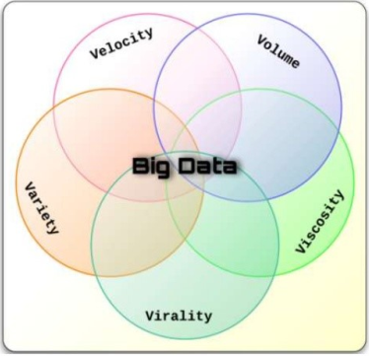
Big Data and its Challenges

Slide 6
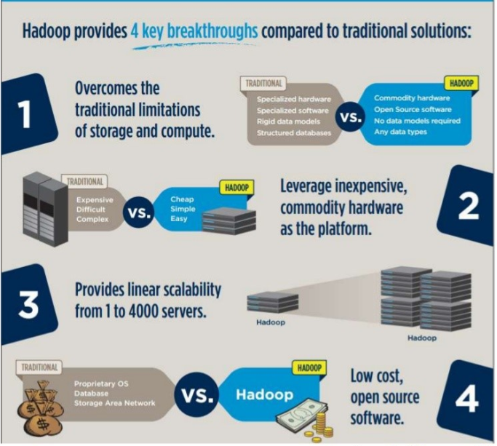
Why Hadoop?

Slide 7
Hadoop and its Characteristics
Apache Hadoop is a framework that allows the distributed processing of large data sets across clusters of commodity computers using a simple programming model.
It is an Open-source Data Management technology with scale-out storage and distributed processing.

Slide 8
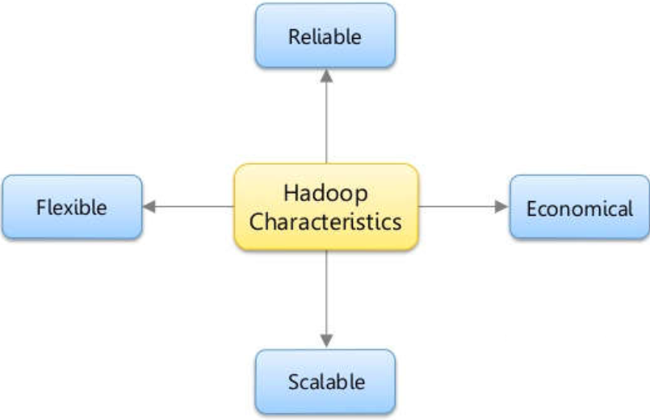
Hadoop and its Characteristics

Slide 9
Introduction to Hadoop
HDFS
Hadoop Distributed File System
A distributed, scalable, and portable file system written in Java for the Hadoop framework.
Provides high-throughput access to application data.
Runs on large clusters of commodity machines.
Is used to store large datasets.

Slide 10
Introduction to Hadoop
MapReduce
Distributed data processing model and execution environment that runs on large clusters of commodity machines.
Also called MR.
Programs are inherently parallel.

Slide 11
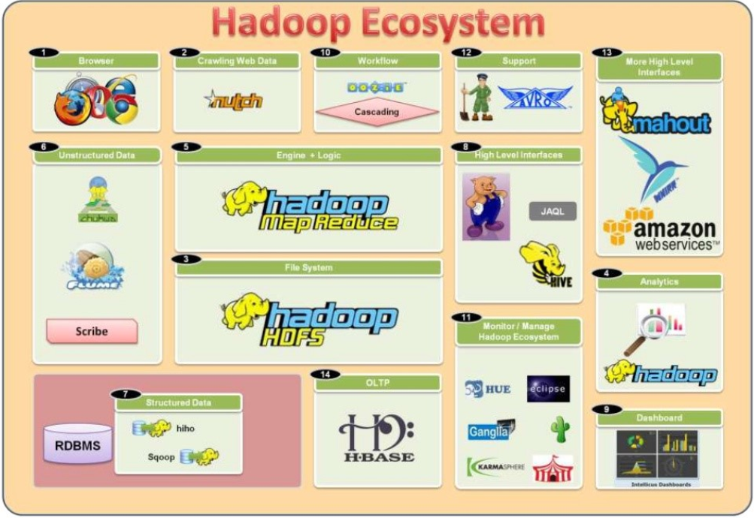
Hadoop Ecosystem

Slide 12
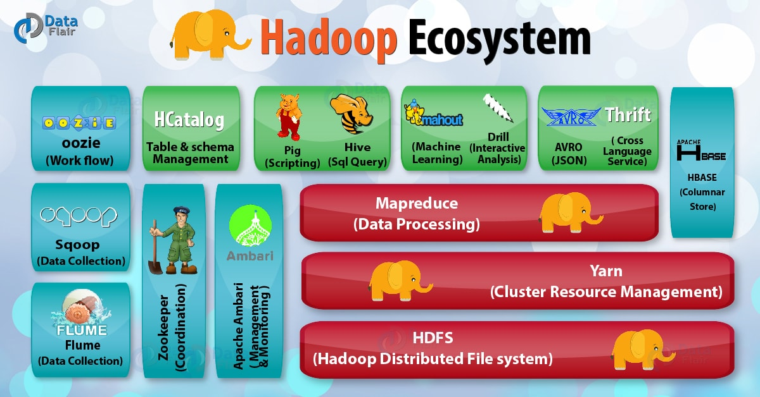
Hadoop Ecosystem

Slide 13
Module Contents
Introduction to Big Data and Hadoop
Introduction to Pig
Hadoop Pig Architecture

Slide 14
What is Pig?
It is an open source data flow language
Pig Latin is used to express the queries and data manipulation operations in simple scripts.
Pig converts the scripts into a sequence of underlying Map Reduce jobs.

Slide 15
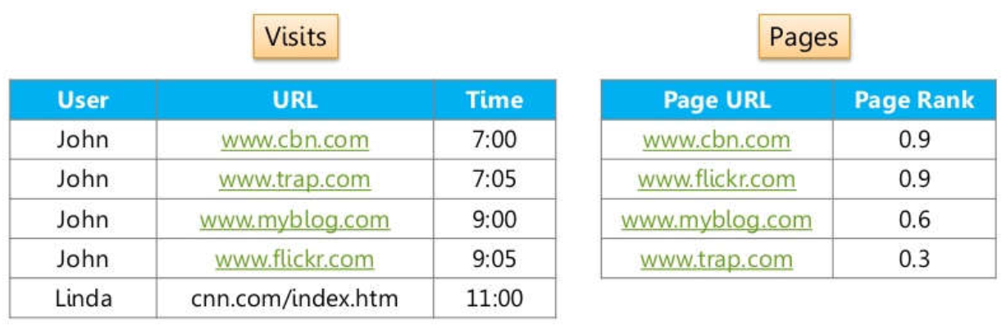
Internalize Pig

Slide 16
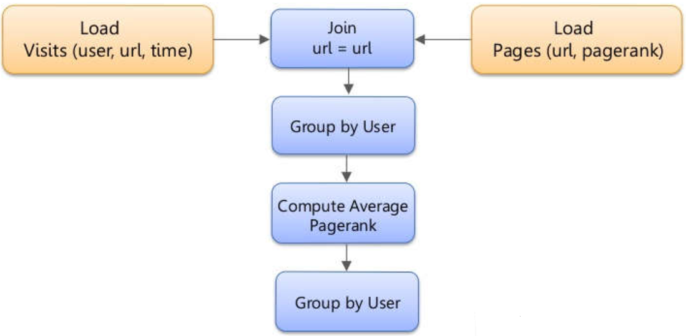
Internalizing Pig

Slide 17
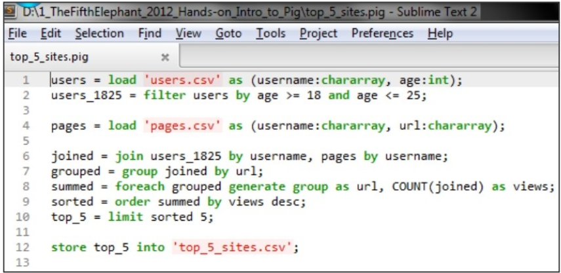
Why Pig?

Slide 18
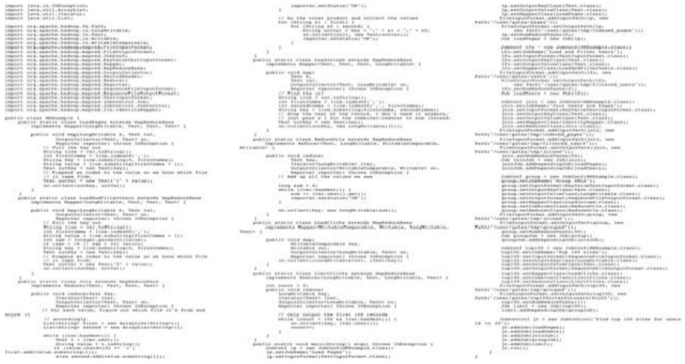
Equivalent Java MapReduce Code

Slide 19
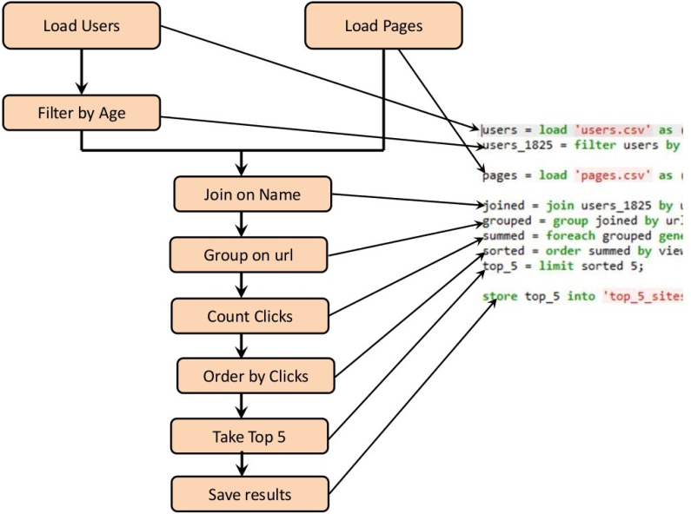
Internalizing Pig

Slide 20
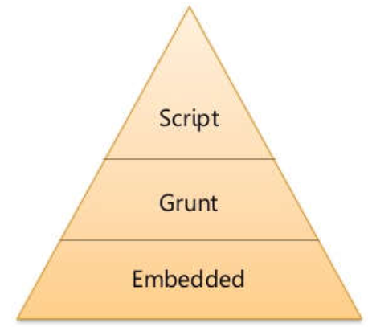
Ways to handle Pig
Grunt Mode
It’s interactive mode of Pig
Very useful for testing syntax checking and ad-hoc data exploration.
Script Mode
Runs set of instructions from a file
Similar to a SQL script file
Embedded Mode
Executes Pig programs from a Java program
Suitable for creating Pig Script on the fly.

Slide 21
Modes of Pig
Local
Need access to a single machine
All files are installed and run using your local host and file system
Is invoked by using the –x local flag.
pig –x local
Map Reduce
The default mode
Need access to a Hadoop cluster and HDFS installation
Can also be invoked by using the –x mapreduce flag or just pig
pig
pig –x mapreduce

Slide 22
Module Contents
Introduction to Big Data and Hadoop
Introduction to Pig
Hadoop Pig Architecture

Slide 23
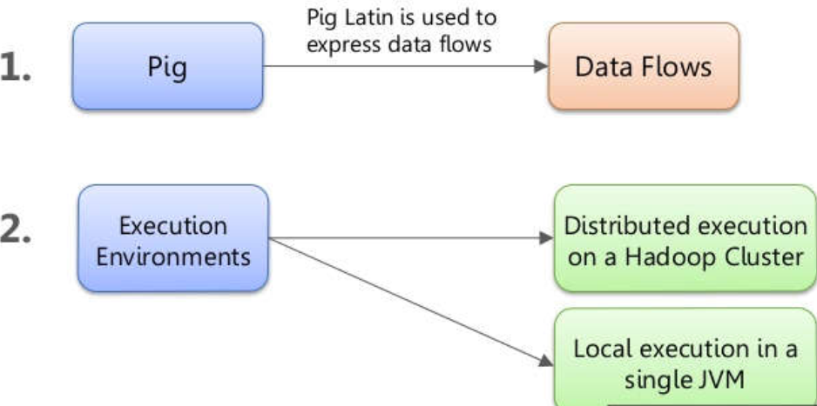
Pig Components

Slide 24

Pig Programs Execution
Pig is just a wrapper on top of MapReduce Layer
It parses, optimizes and converts the Pig script to a series of Map Reduce jobs

Slide 25

Q&A

